Slide 1

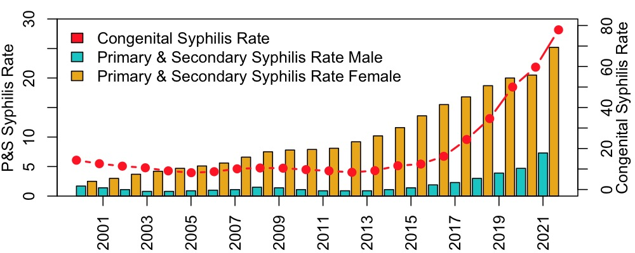
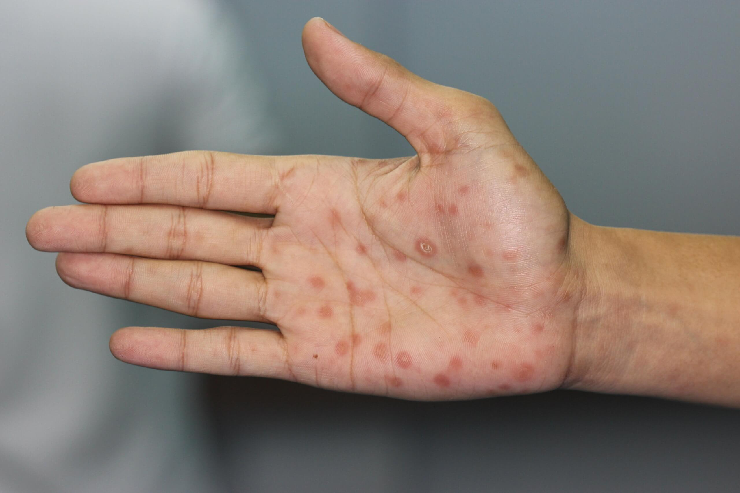
IMAGINE
SYPHILIS
Syphilis is a sexually transmitted infection (STI) caused by the bacterium Treponema pallidum.
If left untreated, it can lead to severe health complications, including neurological and cardiovascular damage, and can be fatal.
It has distinct stages: primary, secondary, latent, and tertiary, each with different symptoms.
National Alarming Trends:
Syphilis rates have quadrupled over the past decade, reaching their highest levels since the 1950s.
Rates of congenital syphilis have risen by an alarming 9-fold since 2013; one in every 1,300 U.S. births in 2021 was complicated by syphilis.

Slide 2
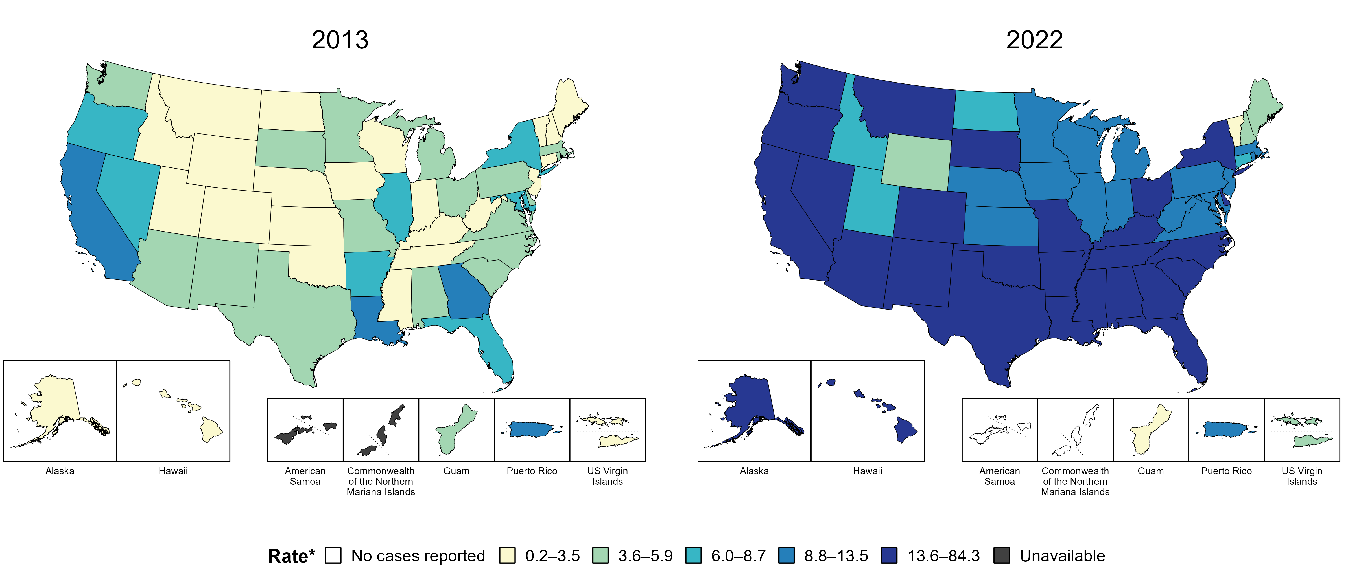
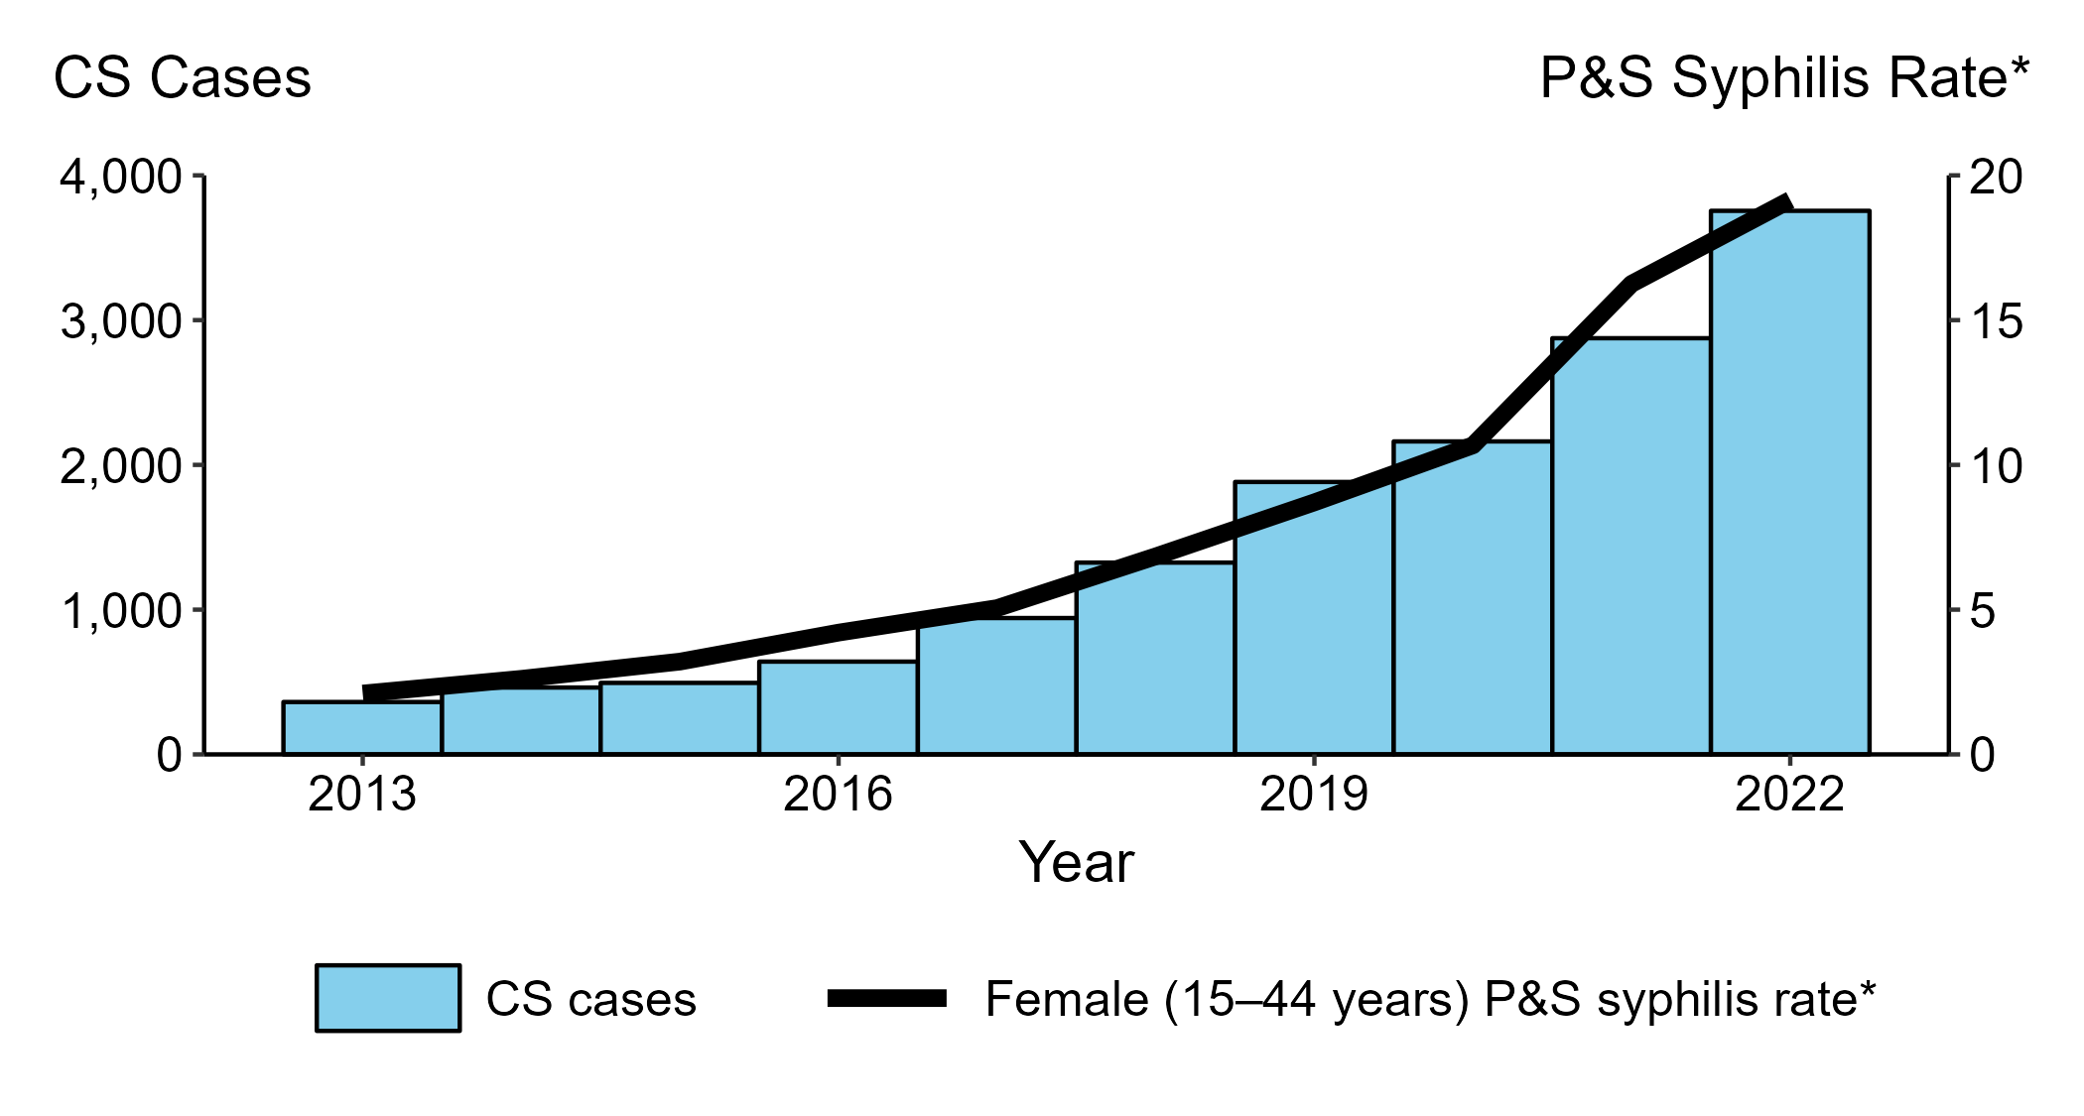
Syphilis in Our Backyard Wisconsin and Milwaukee Under Threat
Wisconsin's Rising Rates:
In Wisconsin, syphilis cases increased by 6.4% from 2022 to 2023, totaling 1,794 reported cases.
Milwaukee's Alarming Statistics:
Milwaukee County has the highest number of reported STI cases in the state.
The Southeastern region, including Milwaukee, reported the highest syphilis rates.
Syphilis cases among women in Wisconsin increased by 309% between 2020 and 2021.
Congenital syphilis cases surged by 350%, leading to severe health complications and infant mortality in 2 out of 5 cases.
Black individuals represent 6% of Wisconsin's population but account for 51% of syphilis infections.
Hispanic/Latino individuals face syphilis rates 2.5 times higher than non-Hispanic Whites.
Congenital Syphilis — Reported Cases by Year of Birth and Rates of Reported Cases of Primary and Secondary Syphilis Among Women Aged 15–44 Years, United States, 2013–2022

Slide 3
Combating the Crisis An AI-Driven Approach for Change
Thank You
Navid Mohseni
Department of Mathematical and Statistical Sciences
Marquette University
There's an urgent need to understand the social determinants driving this resurgence to develop effective interventions.
Utilizing advanced machine learning and Bayesian regression models to analyze syphilis trends.
Identifying key social determinants of health (SDoH) such as poverty, education, housing instability, and healthcare access.
Assist policymakers in allocating resources effectively to areas and populations most in need.
Contribute to decreasing syphilis rates and closing the gap in health outcomes for marginalized communities.

