Slide 1
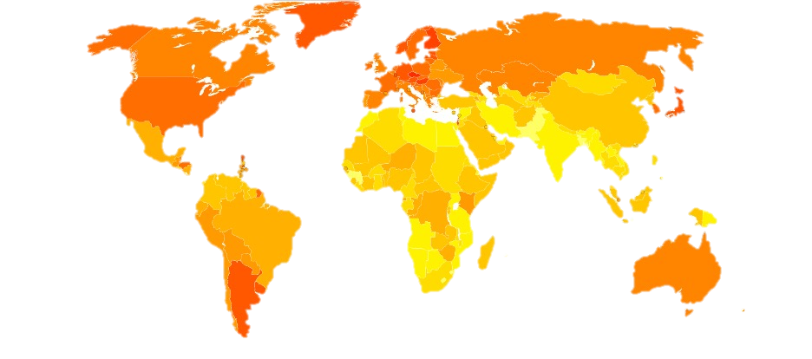
Kernel Smoothing Methods in Spatial Epidemiology
Navid Mohseni

Slide 2
Agenda
Introduction
Intensity and Density Estimation
Bandwidth Selection
Handling Edge Effects
Adaptive Kernel Smoothing
Spatial Relative Risk Function
Conditional Probability of Disease

Slide 3
What is kernel smoothing
Nonparametric method for visualizing spatial data.
Smoothes discrete observations into continuous functions.
Revealing underlying spatial patterns like identifying disease hotspots and clusters.
Notes:
Kernel is a function measuring how similar two things are. Create a smooth, continuous picture from discrete data points. Point process into smooth functions. Splines. Kernel est of density and intensity with low dim data. So kernels help to estimate intensity functions or relative risk across space. Semi-parametric usage (kernel of marginal spatial dist of cases + parametric temporal)

Slide 4



Kernel Intensity and Density Estimation
Intensity function (𝜆(𝑠)): Measures spatial distribution of cases/events
Density function (𝑓(𝑠)): integrates to 1.
Kernel estimation method:
Notes:
Data is from inhomo Poisson process with lambda. The lambda doesn’t have any parametric form. Kernel smoothing for estimation shows the underlying population density. Scaled version of K. h: bandwidth: scaling parameter controls the overall degree of smoothness. Unscaled kernel function: usually symmetric pdf (std bivariate normal = gaussian kernel) or biweight. K(s) = 1/2pi exp(-||s||^2)/2 Rather than intensity it could estimate density: 1/m sum(kh(s – si)

Slide 5

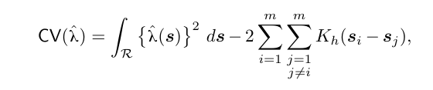
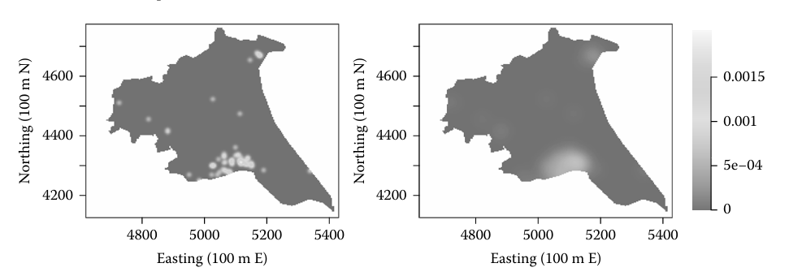
Bandwidth Selection
Bandwidth is the degree of smoothness.
Importance of bandwidth (h):
Small h: noisy estimate.
Large h: oversmoothed, loses details.
Methods for choosing bandwidth:
Subjective visual inspection
Mean Integrated Squared Error (MISE) minimization
Cross-validation (CV)
Oversmoothing (Maximal Principle)
Notes:
Noisy: Capture too much random variations. Difficult to distinguish interesting structures.
Oversmoothed: Not finding important details.
Maximal: maximum amount of smoothing that could be required to min the MISE. MISE: unknown lambda so plug in approaches or pilot estimates.
CV: Leave one out: Varying performance and Producing small bandwidths (maybe there are noise). Maximal: Producing high bandwidths. h =5.79 (chosen by cross validation), and the one in the right-hand panel a bandwidth of h =21.92 (chosen by the oversmoothing principle)

Slide 6


Edge Effects in Kernel Smoothing
Kernels extend beyond the boundaries.
Kernel weights spill over boundaries, causing bias.
Solution: Boundary Correction Factor: To estimate the density/intensity near the boundary.
Notes:
Truncation: Underestimation near region edges.

Slide 7


Adaptive Kernel Smoothing
Limitations of fixed bandwidth:
Difficulties in heterogeneous populations (cities vs rural)
Adaptive kernel smoothing approach:
Bandwidth varies spatially according to local density
Notes:
Depends on the local density of f: the optimal amount of smoothing. Sparse Data = h increased, more dense data: h decreases. So we need something to allow the h varies across regions. Bandwidth in the formula changes with data points. Amount of smoothing is proportional to inverse of the square root of density. Smaller bandwidths in dense regions, larger bandwidths in sparse regions. Challenges: fixed bandwidth estimation: Pilot estimate for unknown f. Global bandwidth: Cross validation Edge Correction is required.

Slide 8

Spatial Relative Risk
𝑓(𝑠): Density of disease cases
𝑔(𝑠): Density of controls (population at risk)
Visualizing relative risk (log-scale):Log-relative risk: 𝜌(𝑠)=log⁡(𝑟(𝑠))
Notes:
Kernel estimates show only how cases are spatially distributed, not how the disease risk varies. So it doesn’t describe the spatial variation of disease risk directly. Underlying population distribution is important.

Slide 9
Challenges in Estimating Relative Risk
Instability in low-density areas
Sensitivity on log-scale:
Errors in low-density areas magnified
Critical importance of bandwidth selection:
Typically, single common bandwidth chosen
Adaptive bandwidth methods recommended
Notes:
Hard to estimate f and g where data is sparse. So again bandwidth is important.

Slide 10
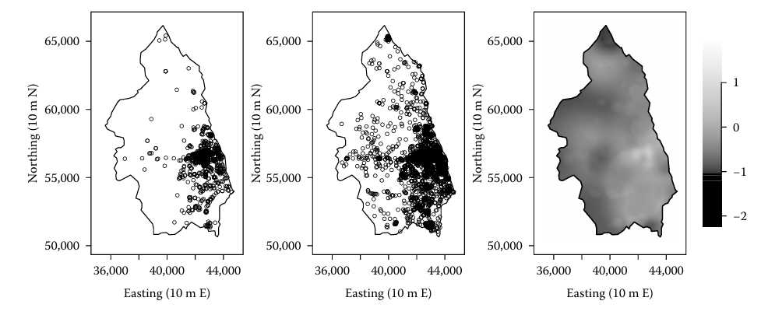
Adaptive Estimation of Relative Risk (Example)
Adaptive kernel method implemented in R (sparr package)
Revealed distinct spatial patterns (urban vs rural differences)

Slide 11

Conditional Probability Estimation
Alternative to relative risk:
Probability of disease given location:
Estimation methods:
Local constant regression (direct estimator)
Local linear binary regression (improved estimator)
Notes:
Plot of Prob of disease as a function of location

Slide 12

Relative Risk vs. Conditional Probability
Choice depends on visualization goals:
Probability scale (local linear regression)
Log-relative risk scale (density ratio method)
Notes:
Differ by scale.

Slide 13
Thank you
Navid Mohseni

