Slide 1
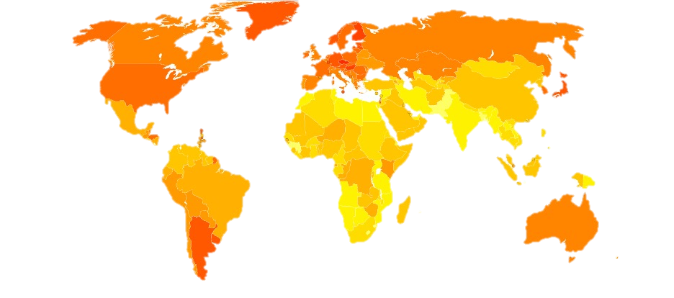
Spatio-Temporal Model of areal data
Navid Mohseni

Slide 2
Agenda
Areal Data
INLA and R-INLA Review
Modeling
Small Area Modeling
Issues with Areal Data
Modeling in R

Slide 3
Areal data
Areal Data:
Domain is fixed
Finite number of areal units with well-defined boundaries (e.g., zip codes)
Aggregated by county and year, like number of deaths in a county-level.
CRS: Coordinate Reference System is used for representation, which gives us the origin and the unit of measurement.
Shapefile is a group of files (.shp, .shx, .dbf, …) that define geometrics and attributes of spatial features.
Notes:
Fixed domain is partitioned into a finite number of subregions at which outcomes are aggregated. 2D, 3D UTM zones

Slide 4
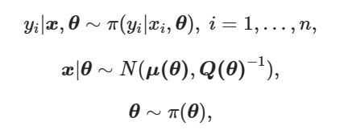
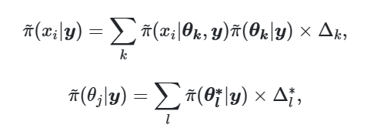
INLA Quick Review
Approximate Bayesian inference in latent gaussian models.
Bayesian Hierarchical modeling: variation in response ~ risk factors + random effects
Useful in GLMM to Spatio-temporal models.
INLA uses Laplace approximations and sparse matrix tricks.
Gaussian latent is when the hidden variables follow a multivariate normal distribution.
Notes:
X is a vector of latent gaussian variables. Write eta_i: mu(y_i) = eta = … numerical integration: estimating integrals by using sums, and analytical approx. like laplace.

Slide 5
R-INLA Quick Review
Syntax like lm()
f() is used for random effect part of the model.
inla(formula, data, family, control.compute, control.predictor)
summary(inla_output)
inla_output$summary.fixed
Notes:
F(I, model): I is the index vector that specifies the element of the random effect that applies to each observation. Control.compute for computing variables like DIC, control.predictors: link function, marginal densities, …) like priors.

Slide 6

Modeling
SIR: Standardized Incidence Ratio
BHM: Borrow info from neighborhoods and incorporate the covariate info.
Spatial Model: 1. Spatial Random Effect + Unstructured component (uncorrelated noise)
Spatial Neighborhood or Proximity Matrix : W matrix
$W_{ij}=1$ if regions i and j share a common boundary.
Notes:
Or closed within a specified distance, or if j is one of m neighbors of I, or inverse distance btw areas.
Ei = r_i (rate in population) * n_i (population of area i)

Slide 7




Small Area Modeling
Besag Model:
Spatio-temporal small area disease risk estimation:
Notes:
Penalized Complexity Priors (PC priors):
Extension of simple base model
Penalizes deviation from the base model, which improves flexibility.
Sigma_i is set of neighbors and n_sigma_i is number of neighbors in area i. j∼ij \sim ij∼i: areas neighboring iii
nin_ini​: number of neighbors of iii
📌 Interpretation: Each area’s spatial effect is centered on the average of its neighbors — this induces local spatial smoothing.

Slide 8
Issues with Areal Data
MIDP: Misaligned Data Problem
MAUP: Modifiable areal unit problem
Ecological Fallacy
Notes:
MIDP (Misaligned Data Problem)
Occurs when data are collected at one spatial scale and used at another.
Example:
Cases aggregated at county level
Pollution data available only at ZIP code or point-level monitors
Aggregating data to coarser units (e.g., ZIP → County → State) changes results.
Zoning Effect: Even with same scale, how you group areas affects results.
💡 Your choice of spatial boundaries can change correlations and trends.
Conclusions drawn at the group level don’t apply at the individual level.
Example:
Area with high pollution and high lung cancer → infer that every individual has high risk (not necessarily true).

Slide 9
Modeling in R
Estimate expected lung cancer cases in Ohio counties from 1968 to 1988 using indirect standardization.
Compute Standardized Incidence Ratios (SIRs) to identify areas with higher or lower than expected disease burden.
Fit a Bayesian spatio-temporal model using R-INLA to estimate smoothed disease risks, accounting for spatial and temporal correlation.
Visualize results through Static maps of SIR and relative risk (RR) using ggplot2

Slide 10
Data Preparation
county year y n NAME
<dbl> <dbl> <dbl> <dbl> <chr>
1 1 1968 6 8912 Adams
2 1 1968 0 24 Adams
3 1 1968 0 8994 Adams
4 1 1968 0 22 Adams
5 1 1969 5 9139 Adams
6 1 1969 0 20 Adams
7 1 1969 0 9289 Adams
8 1 1969 0 24 Adams
9 1 1970 8 9455 Adams
10 1 1970 0 18 Adams
> head(d)
county year Y E SIR idarea idarea1 idtime
1 Adams 1968 6 8.278660 0.7247549 1 1 1
2 Adams 1969 5 8.501767 0.5881130 1 1 2
3 Adams 1970 9 8.779313 1.0251372 1 1 3
4 Adams 1971 6 9.175276 0.6539313 1 1 4
5 Adams 1972 10 9.548736 1.0472591 1 1 5
6 Adams 1973 7 10.099777 0.6930846 1 1 6
> head(dE)
county year E
1 Adams 1968 8.278660
2 Adams 1969 8.501767
3 Adams 1970 8.779313
4 Adams 1971 9.175276
5 Adams 1972 9.548736
6 Adams 1973 10.099777
E <- expected( population = dohio$n, cases = dohio$y)
d$SIR <- d$Y / d$E

Slide 11
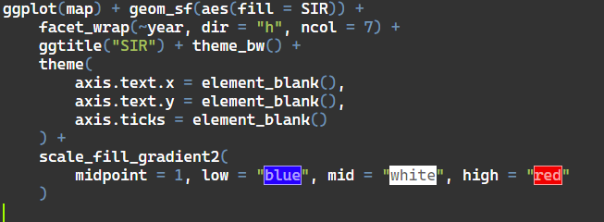
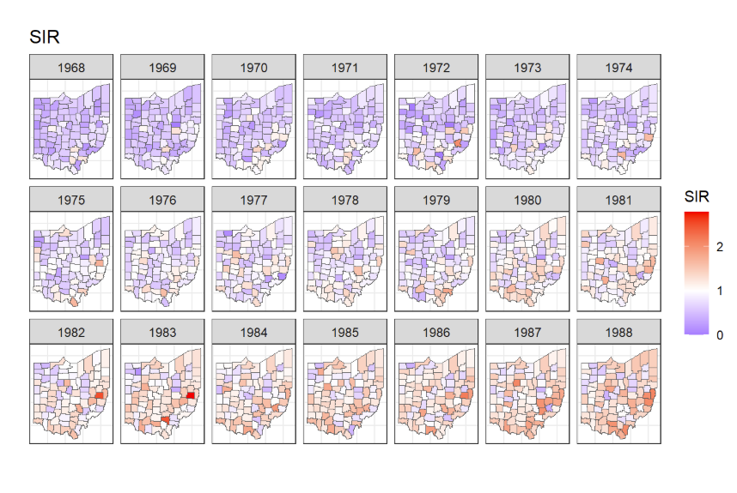
GGplot2

Slide 12
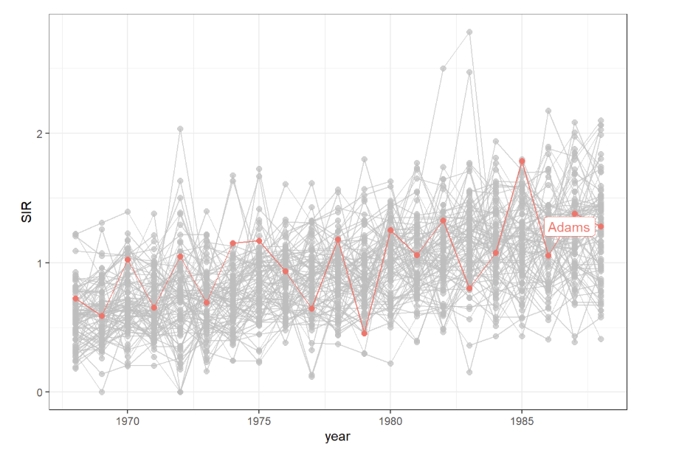
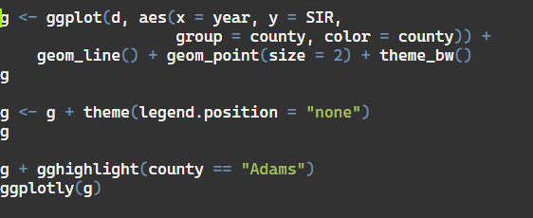
ggplot2

Slide 13
R COdes
neighborhood matrix needed to define the spatial random effect by using the poly2nb() and the nb2INLA()
nb <- poly2nb(map)
nb2INLA("map.adj", nb)
g <- inla.read.graph(filename = "map.adj")
d$idarea <- as.numeric(as.factor(d$county))
d$idarea1 <- d$idarea
d$idtime <- 1 + d$year - min(d$year)
formula <- Y ~ f(idarea, model = "bym", graph = g) +
f(idarea1, idtime, model = "iid") + idtime
res <- inla(formula,
family = "poisson", data = d, E = E,
control.predictor = list(compute = TRUE)
)
ggplot(map) + geom_sf(aes(fill = RR)) +
facet_wrap(~year, dir = "h", ncol = 7) +
ggtitle("RR") + theme_bw() +
theme(
axis.text.x = element_blank(),
axis.text.y = element_blank(),
axis.ticks = element_blank()
) +
scale_fill_gradient2(
midpoint = 1, low = "blue", mid = "white", high = "red"
)
Notes:
d$RR <- res$summary.fitted.values[, "mean"]
d$LL <- res$summary.fitted.values[, "0.025quant"]
d$UL <- res$summary.fitted.values[, "0.975quant"]
# Get list of neighbors for each area # Convert to INLA-readable format # Read adjacency graph into INLA # Spatial index # Copy for interaction term # Time index (1968 = 1, ..., 1988 = 21) # Spatial effect (BYM = structured + unstructured) # Interaction: area-specific trend # Global time trend

Slide 14
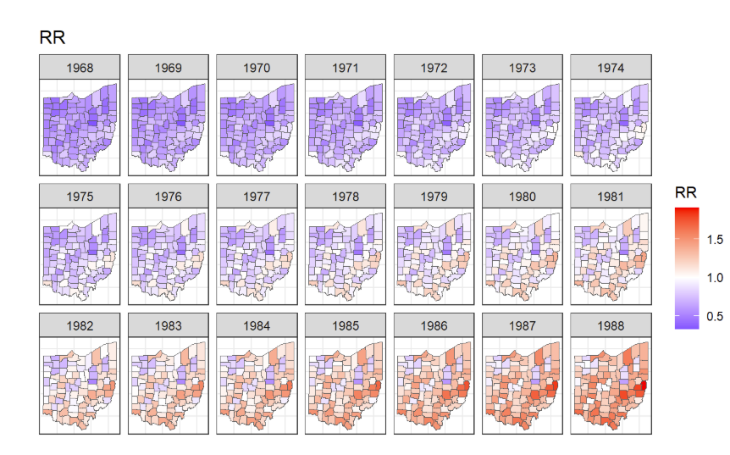
Final Plot

Slide 15
Thank you
Navid Mohseni

