Slide 1
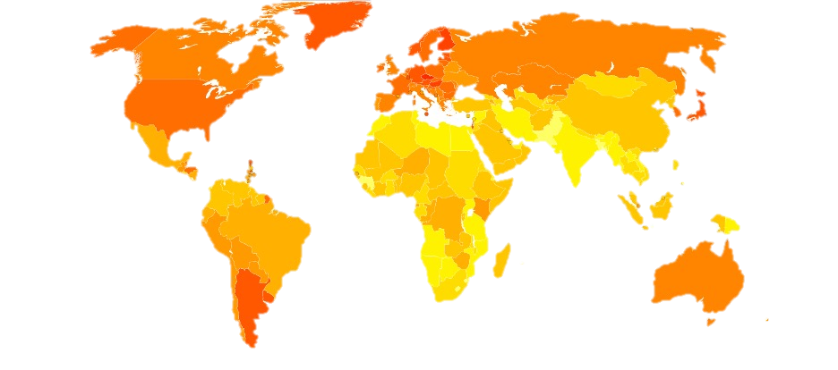
Temporal models Implementation in R-INLA
Navid Mohseni

Slide 2
Agenda
Introduction
Autoregressive Models
Non-Gaussian Data
Forecasting
Spatio-Temporal Models

Slide 3
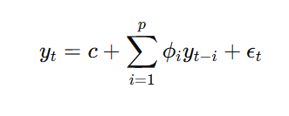
What Is Autoregressive (AR) model
An autoregressive (AR) model is a type of time series model where the value of a variable at a given time depends on its own past values. It assumes that past observations contain useful information for predicting future observations.

Slide 4
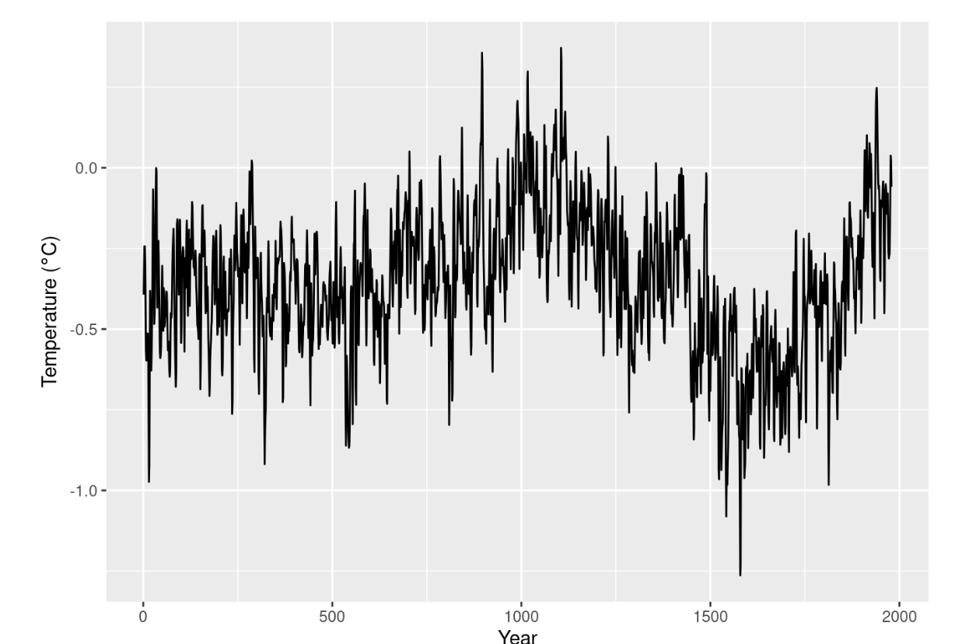
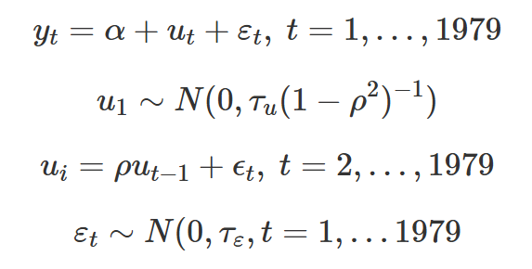
Bayesian AR
The Bayesian AR model in INLA includes a latent (hidden) process​ that captures temporal dependency:
Data: Climate reconstruction dataset: values represent the temperature anomalies (in Celsius degrees) from the Northern Hemisphere annual mean temperature 1961-90 average
Y can be Considered a Gaussian Response with a Fixed Large Precision
In the Bayesian AR(1) model, U is a latent (hidden) autoregressive component that captures the underlying trend in the time series. It is not directly observed but inferred from the data and explains the temporal dependence in the data.
Notes:
The AR(1) process is smooth when rho is close to 1, meaning past values strongly predict future values. The latent trend refers to the underlying pattern in the time series that we believe exists but is not directly observed
yt​ is the value of the time series at time t, c is a constant (intercept), phi are the autoregressive coefficients, which measure how past values influence the current value, epsilon​ is the error term (assumed to be white noise).

Slide 5
Why do We need a Latent Trend?
Smoothing Temporal Variability
The latent process 𝑢​ smooths out short-term fluctuations and reveals the true underlying pattern in the data.
Separating Signal from Noise
If we modeled 𝑦 directly without a latent component, we might overfit noisy fluctuations. The latent trend helps us focus on the long-term structure of the data.
Making Better Predictions
Once we estimate 𝑢 , we can make predictions for future time points, assuming the temporal structure continues.

Slide 6
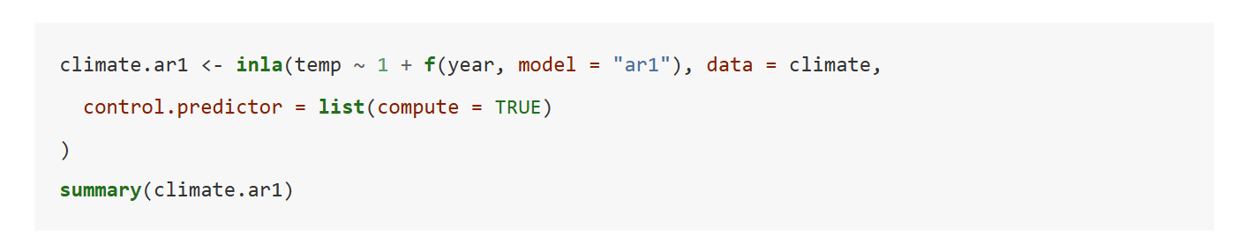
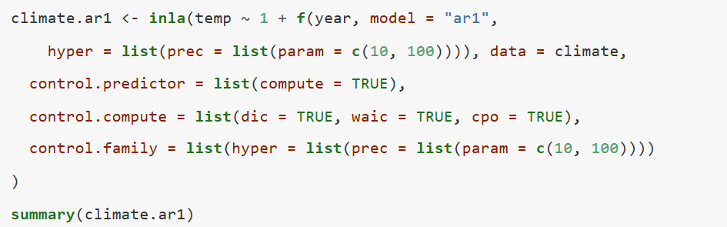
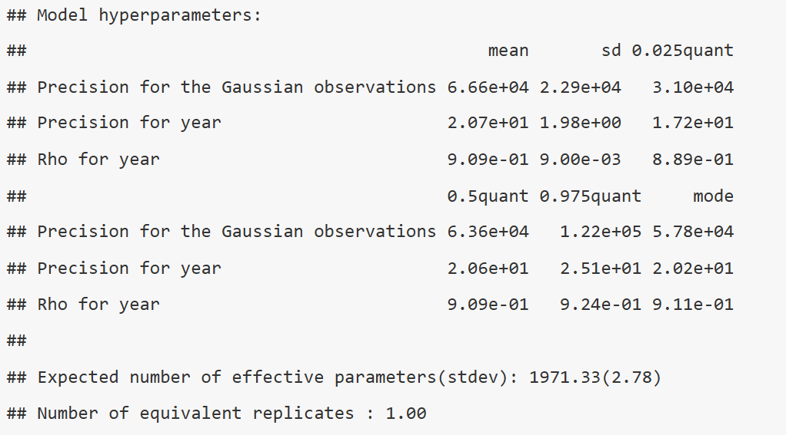
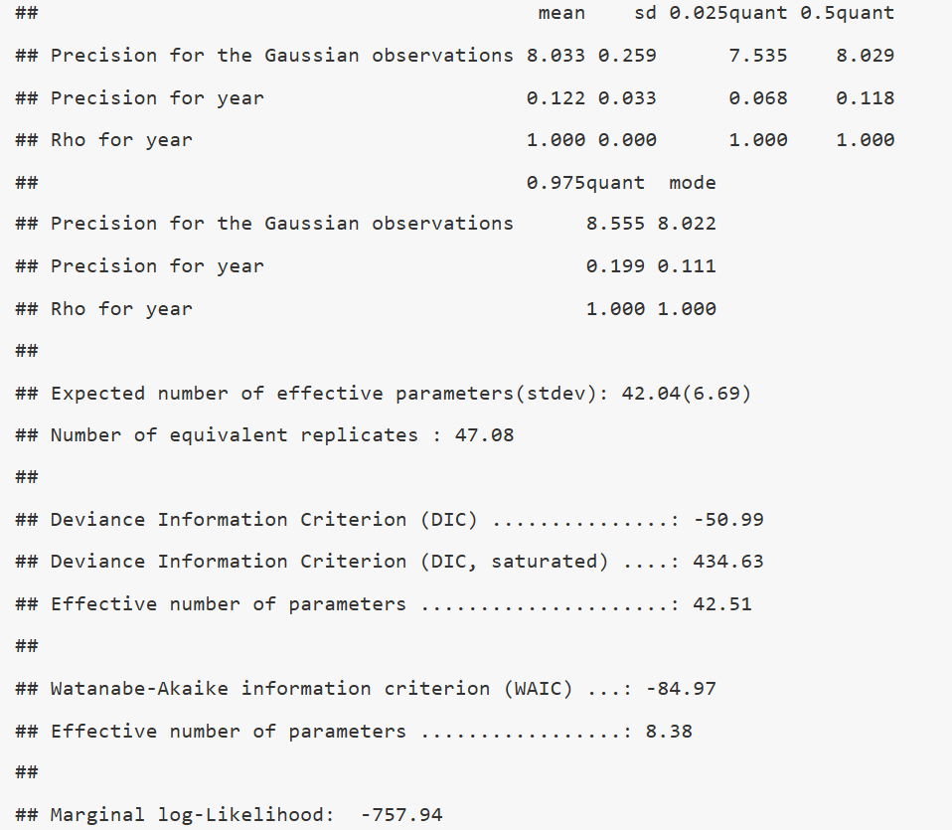
AR(1) in INLA
Notes:
Precision is the inverse of variance. Such an extremely high precision means the variance of the residual errors is very small. This suggests that the model is fitting the data almost exactly without allowing for reasonable variation. The correlation between successive years (ρ\rhoρ) is very high (close to 1).This means the model is heavily relying on past values to predict future ones.
Here, a Gamma(10, 100) prior is used:
It centers the precision around 0.1 (which corresponds to a more reasonable variance).
It has low variance to ensure the model does not overfit.

Slide 7
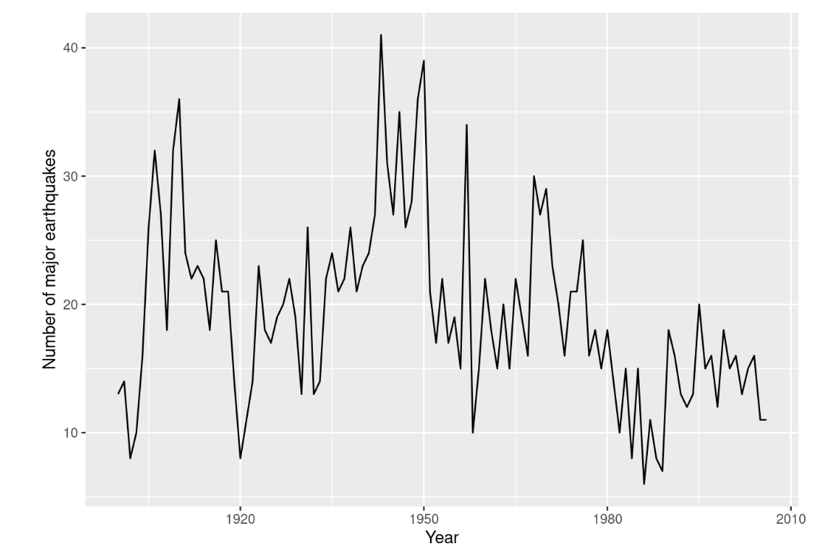
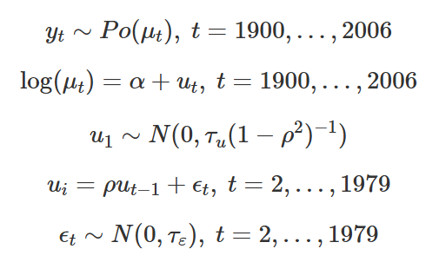
Non-Gaussian Data
Dataset: uses the number of yearly major earthquakes from 1900 to 2006.

Slide 8
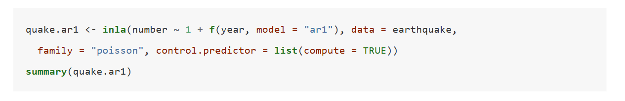
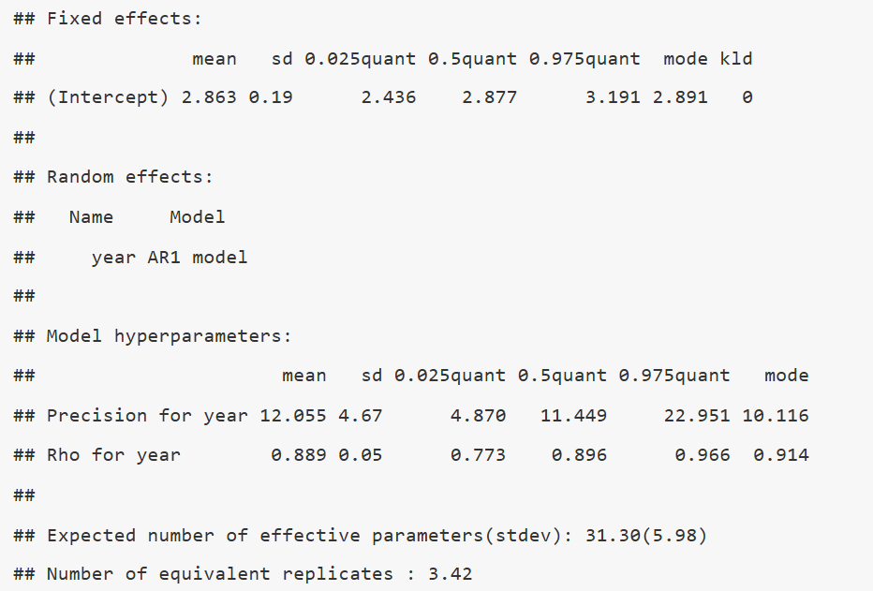
Autoregressive models for non-gaussian

Slide 9
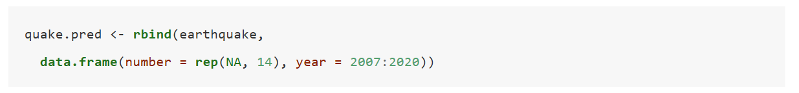
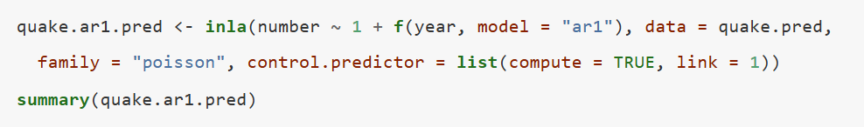
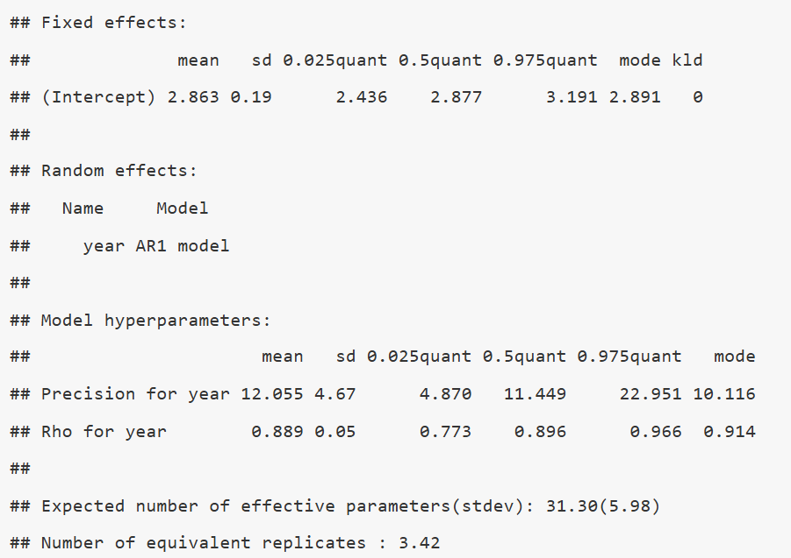
Bayesian timeseries Forecasting with r-inla
Forecasting in Bayesian inference is treated as a missing data problem. Essentially, we:
Fit a model to the observed data.
Extend the dataset by adding future time points where the response is unknown (set to NA).
Compute the predictive distribution for these missing values, incorporating uncertainty.

Slide 10
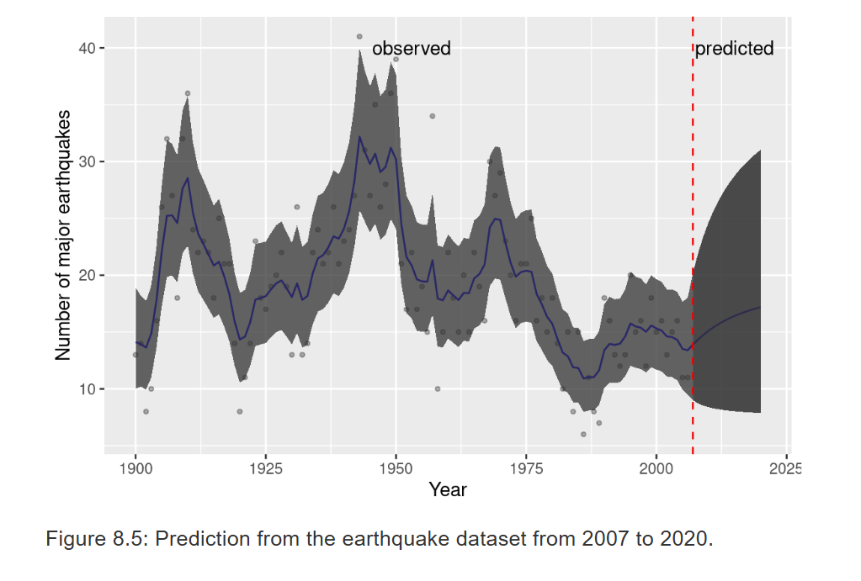

Slide 11
Spatio-temporal models
Spatio-temporal models extend spatial models by incorporating a temporal component, allowing us to model both spatial correlation and temporal correlation simultaneously. These models are commonly used in epidemiology, climate modeling, and ecological studies.
Separable models: The space-time covariance structure can be decomposed into independent spatial and temporal components.
Non-separable models: The space-time interaction is explicitly modeled, making it more complex but capturing localized trends.

Slide 12
Separable Spatio-Temporal Models
These models assume that spatial and temporal effects are independent, meaning we can model them separately. The Kronecker product of a spatial and a temporal covariance structure is often used to define their joint behavior.
The brainNM dataset from the DClusterm package contains:
Observed cases of brain cancer.
Expected cases (adjusted for population size).
SMR (Standardized Mortality Ratio): An estimate of relative risk.
Years (1973-1991).
Counties in New Mexico.
Goal: Model how brain cancer cases evolve spatially (counties) and temporally (years).
Notes:
The Kronecker product is a mathematical operation that produces a block matrix from two smaller matrices. It is denoted as ⊗ and is used in spatio-temporal modeling to represent covariance structures that are separable in space and time. In INLA, separable spatio-temporal models assume that the covariance structure can be written as:
τ(Σb⊗Σw)\tau (\Sigma_b \otimes \Sigma_w)τ(Σb​⊗Σw​)where:
Σb\Sigma_bΣb​ captures between-group correlation (e.g., time),
Σw\Sigma_wΣw​ captures within-group correlation (e.g., space),
τ\tauτ is a precision parameter.

Slide 13
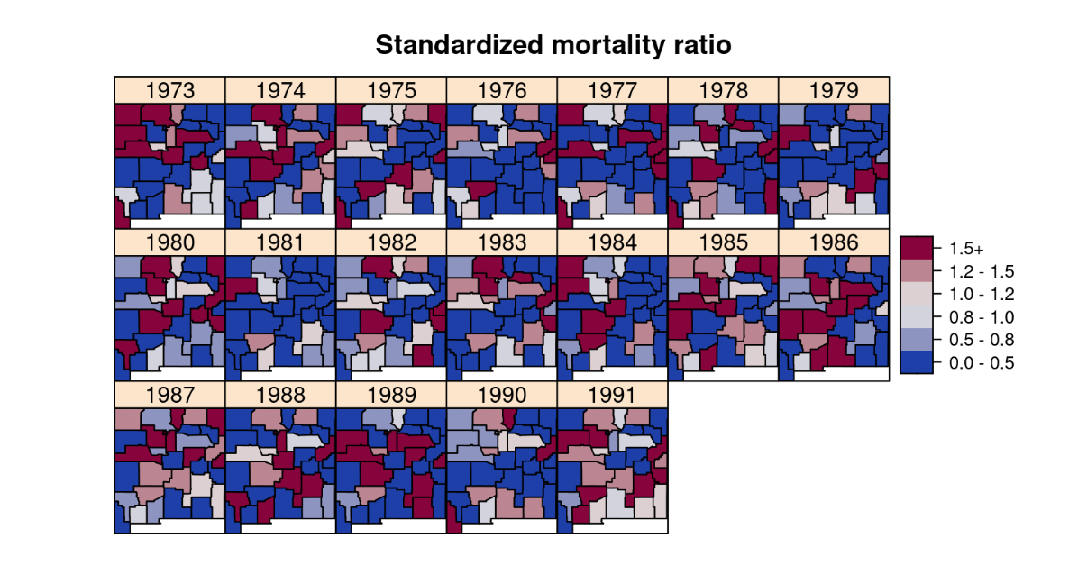
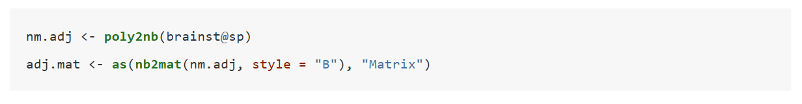
Steps
Before fitting the model, we define the adjacency structure of the counties:
poly2nb() creates a neighborhood adjacency list for counties.
nb2mat() converts it into a matrix for INLA.
Notes:
"B"Binary weights (1 if neighbors, 0 otherwise).

Slide 14
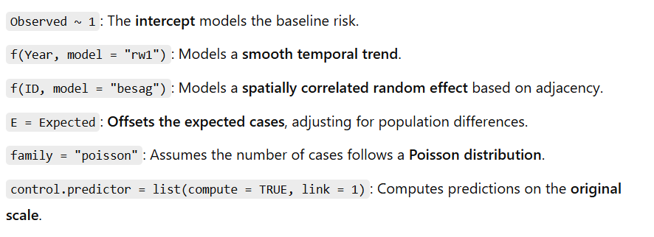
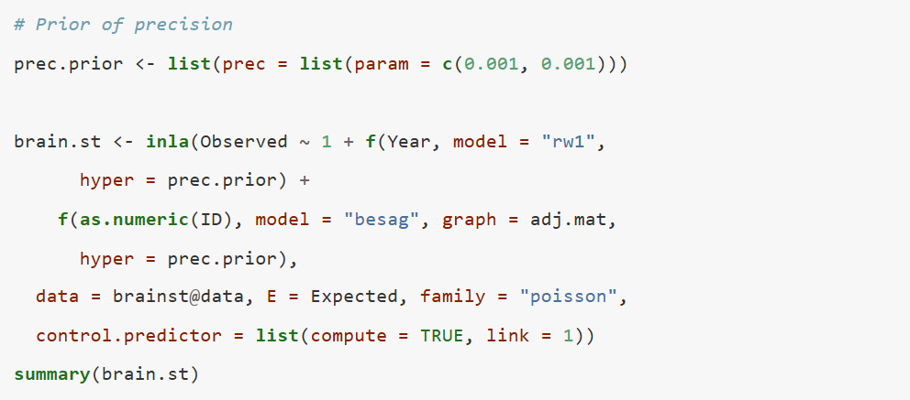
Step 2: Define the Model
The model includes:
RW1 (Random Walk of Order 1) for Time (Year): Models smooth temporal evolution.
Besag ICAR Model for Space (Counties): Models spatial correlation between neighboring counties.
Notes:
The Besag model (often referred to as the Intrinsic Conditional Autoregressive model or ICAR) is used for spatial smoothing.It models spatial dependence by assuming that neighboring regions have similar values. The ICAR model imposes a spatial smoothing prior, penalizing large differences between neighboring areas.

Slide 15
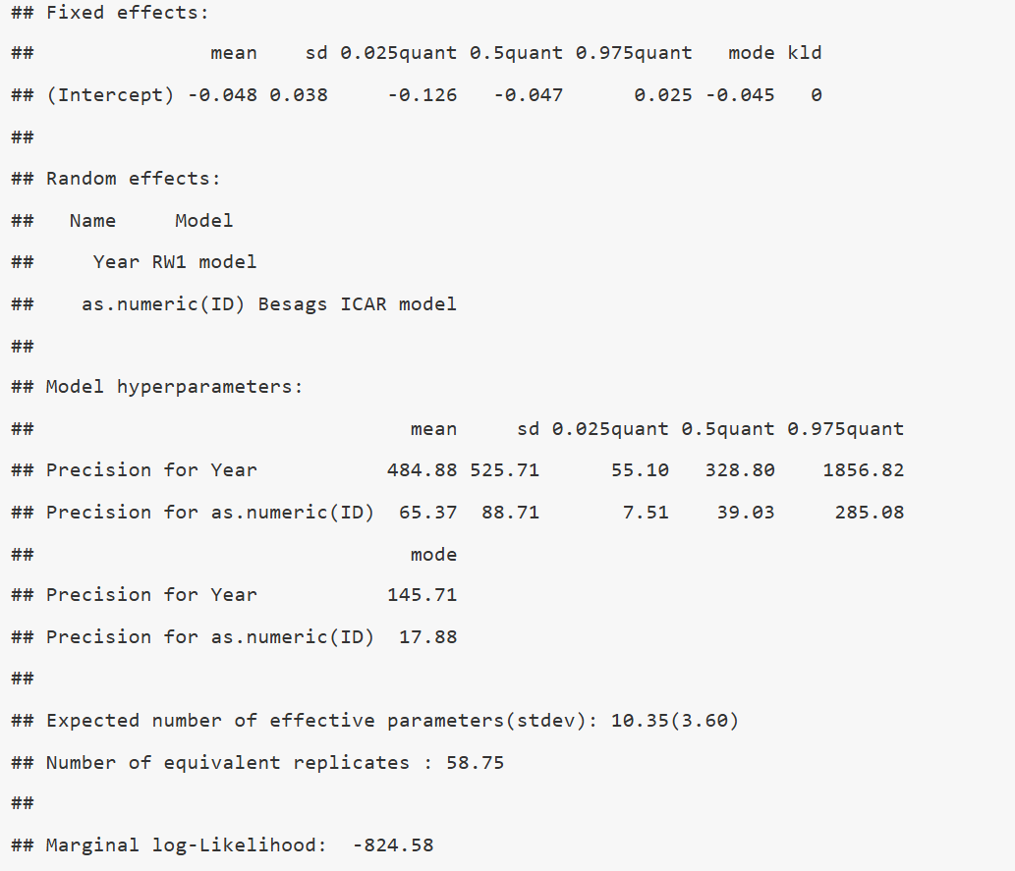
Step 3: Model Summary and Interpretation
Key results:
Fixed effects:
The intercept is -0.048, indicating the baseline risk (log-scale).
Random effects:
The RW1 model for Year captures the overall time trend.
The Besag ICAR model captures the spatial correlation between counties.
Precision estimates:
High precision for the RW1 time component suggests a smooth trend.
Moderate precision for spatial effects suggests variation between counties.
Notes:
RW1 (Year)484.88Very high, implying a smooth time trend (low variability over time): This suggests that the temporal effect is smooth—there are no drastic fluctuations from year to year.This is expected since disease incidence generally changes gradually over time. Besag ICAR (Counties)65.37Moderate, meaning there is variation between counties, but spatial correlation is still strong: Lower than RW1, indicating more variability in disease risk between counties than in the temporal trend.The spatial effect is still moderate, meaning neighboring counties are correlated but can still have some unique variations.

Slide 16
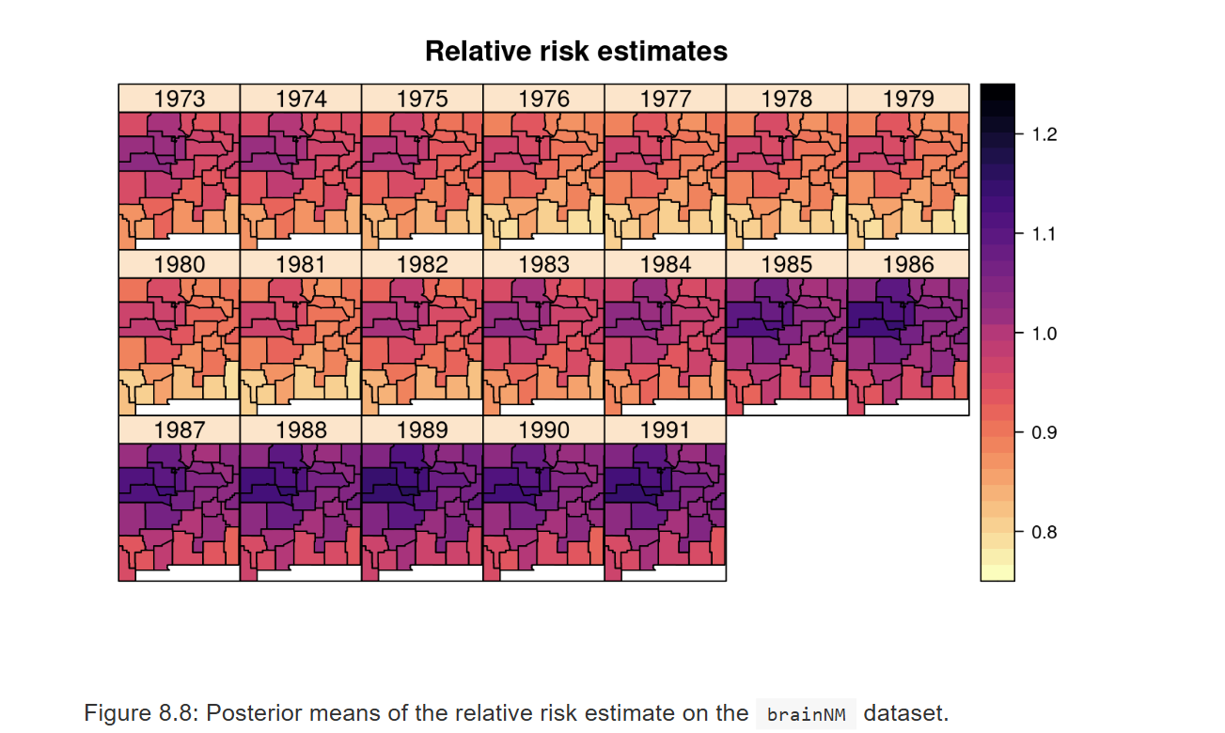
This model assumes the spatial and temporal effects act independently.
No interaction between space and time.
County-specific trends are not modeled, which may lead to poor fitting in some regions.

Slide 17
Understanding Spatio-Temporal Models with the group Option in INLA
The group option in the f() function allows us to define grouped temporal structures when modeling spatio-temporal effects in Bayesian disease mapping. This approach enables us to incorporate structured temporal dependencies (such as autoregressive models) within a spatial model.
The group argument in f() helps define spatio-temporal dependencies, allowing spatial effects to evolve over time. By default, spatial random effects (e.g., Besag’s ICAR model) assume a single time-invariant spatial effect. However, with group, each spatial unit (e.g., counties in New Mexico) has a temporal structure that can be modeled with:
AR(1) (autoregressive of order 1): Captures gradual changes over time.
RW1/RW2 (random walks): Captures smoother temporal trends.
Notes:
Standard spatial models assume a single spatial effect across all time points.With group, each spatial unit (e.g., a county) has its own time-dependent structure.This means we can model changes over time within each county rather than assuming the same spatial effect across all years. spatial effects to evolve over time.

Slide 18
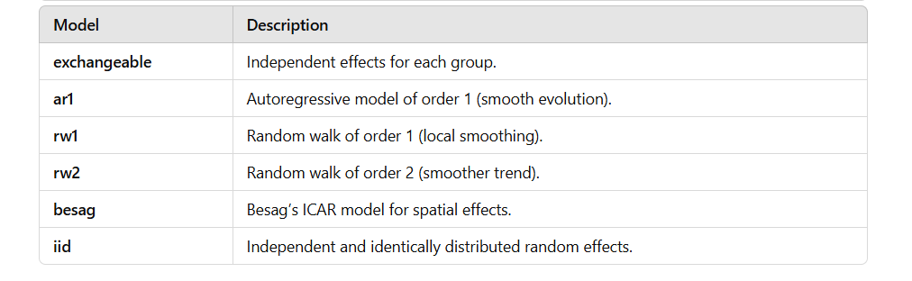
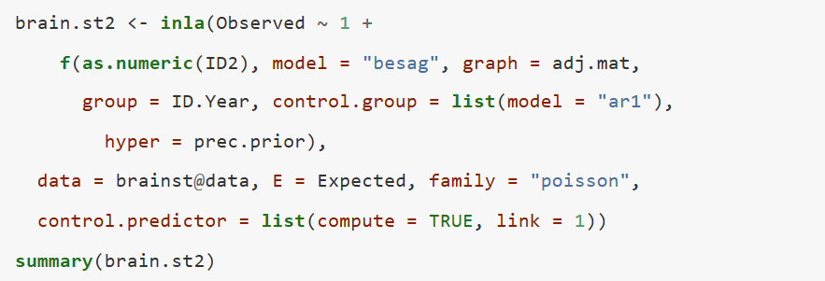
Fit the Spatio-Temporal Model
Notes:
RW1 for Year.Besag ICAR for Counties.Group = AR1 for temporal evolution.

Slide 19
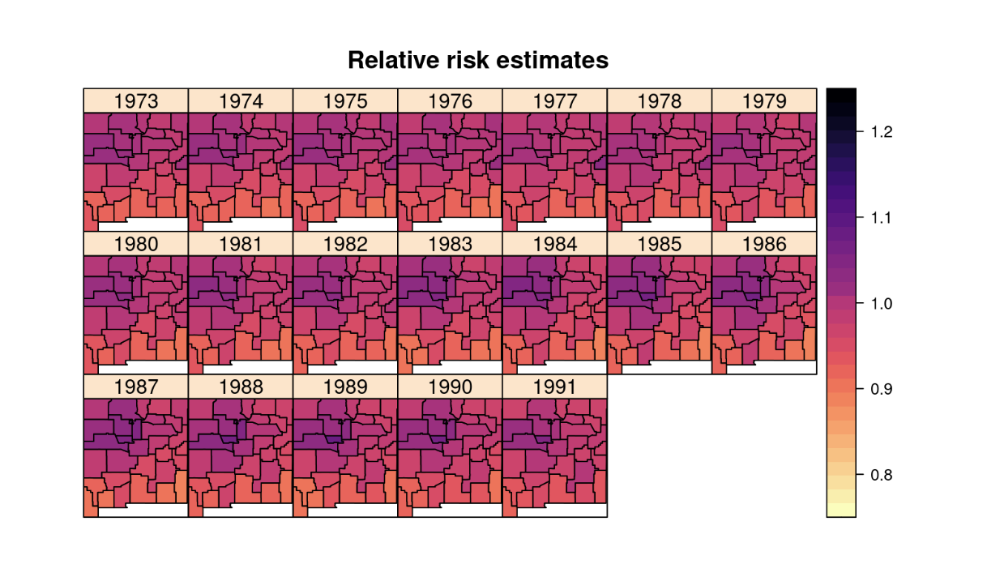
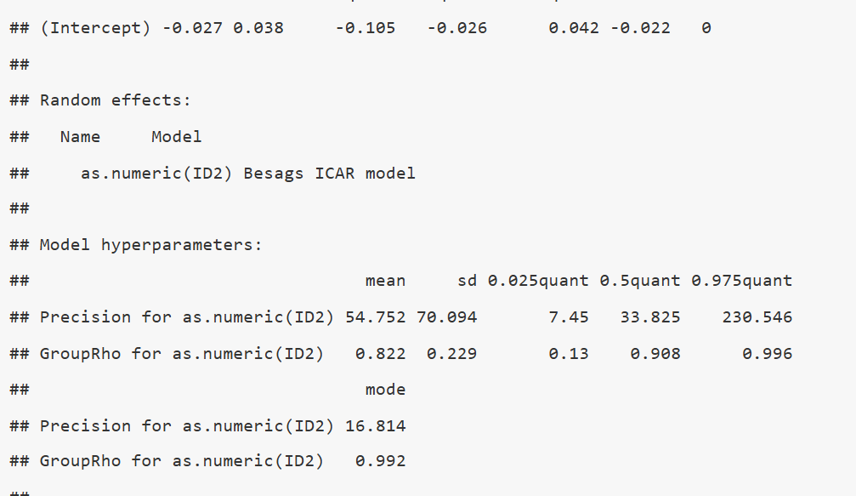
Results
High spatial precision: Suggests low spatial variability after accounting for temporal effects.
High temporal correlation (Group Rho = 0.822): Suggests strong year-to-year dependence, meaning each county's cancer rate does not change abruptly over time.

Slide 20
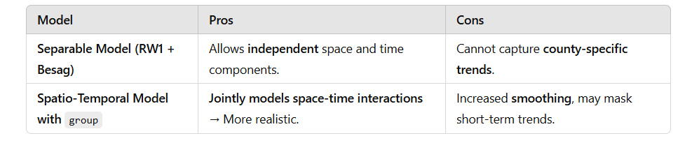
If space and time are independent, use separable models.
If we expect counties to evolve similarly over time, use group-based models.

Slide 21
Thank you
Navid Mohseni

