Slide 1
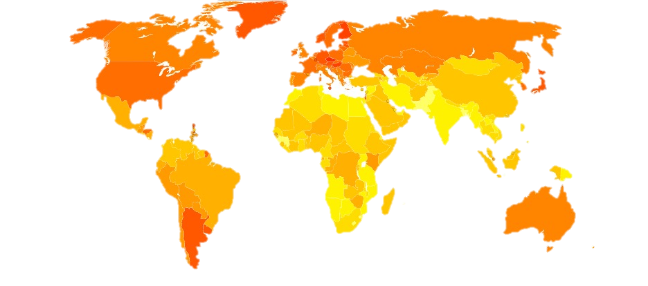
Introduction to Bayesian Disease Mapping with R-INLA
Navid Mohseni

Slide 2
Agenda
Introduction
What is INLA
Setting Up R-INLA
Bayesian Disease Mapping with R-INLA
Results
Summary

Slide 3
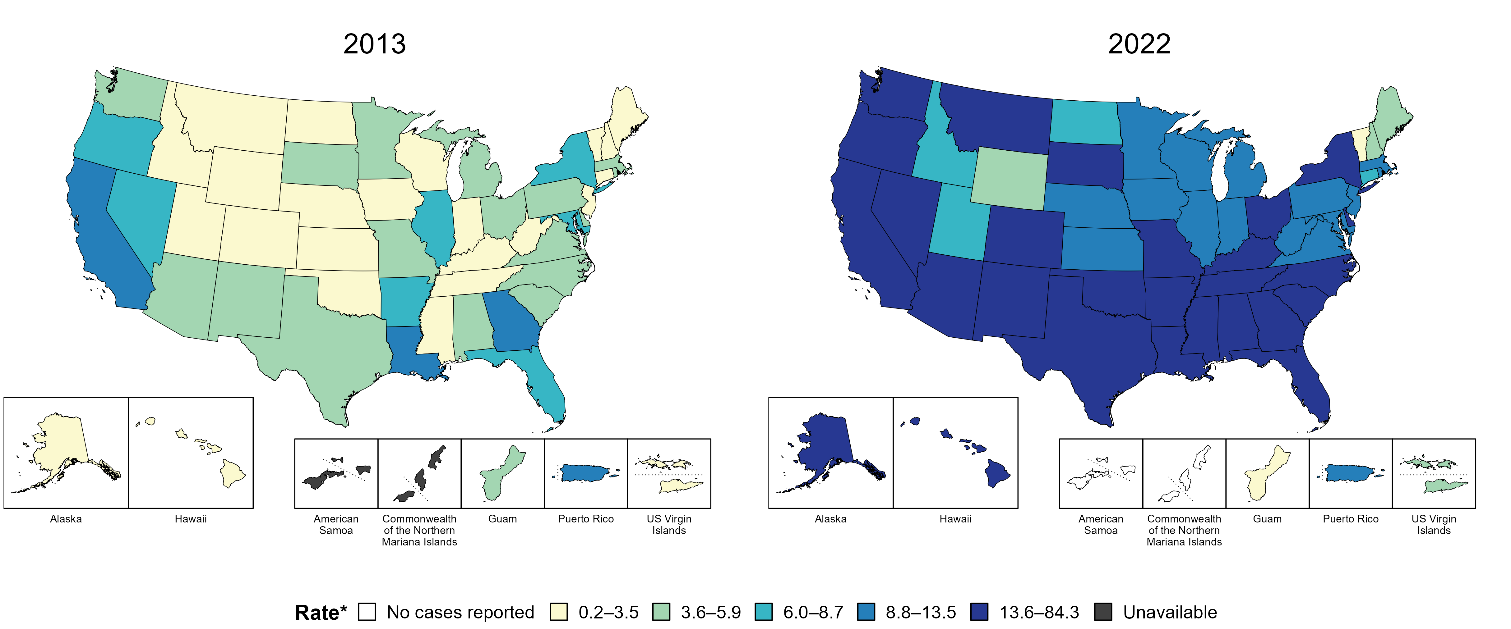
Introduction to Bayesian Disease Mapping
Disease Mapping
  Spatial Correlation
  Policy Decisions
  Early Detection
Notes:
Disease mapping visualizes geographic variations in disease risk. Helps in identifying high-risk areas for public health interventions. Often used in epidemiology, environmental health, and policy-making.

Slide 4
Bayesian MEthods
Frequentist approach
Ignores spatial dependence, leading to unstable estimates in low-count areas.
Limited ability to incorporate prior knowledge (e.g., historical disease rates).
Bayesian methods combine prior knowledge with observed data.
Allow for better uncertainty quantification in disease estimates.
Flexible modeling for spatial and spatio-temporal correlations.
Notes:
Smooths risk estimates across regions → Better precision.
✅ Handles rare diseases better → Overcomes small-area estimation issues.
✅ Provides full posterior distributions → Uncertainty quantification.
✅ Can include prior information (e.g., previous studies, expert knowledge).

Slide 5
What Is INLA
INLA (Integrated Nested Laplace Approximation) is a deterministic Bayesian inference method that approximates posterior distribution using Laplace approximation instead of sampling methods like MCMC.
  Faster than MCMC for large and complex models.
  Does not require sampling, instead it approximates posterior marginals.
  More efficient for hierarchical models; like Spatial and Temporal structures.

Slide 6



INLA MAth
The vector of latent effects will be represented as:
INLA approximates marginal likelihood of the model efficiently, by exploiting the sparsity and conditional independence properties of Gaussian Markov Random Field (GMFR).
Notes:
Provide sufficient inference for most applications.
Marginals are easier to approx. using laplace methods
Joint post is often too complex to store in high dim models.
GMFR: is a gaussian process with sparse precision matrix; which each variable (node) only depends on a few neighbors.

Slide 7


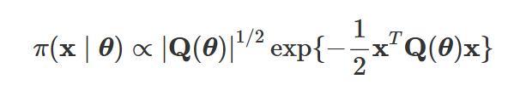
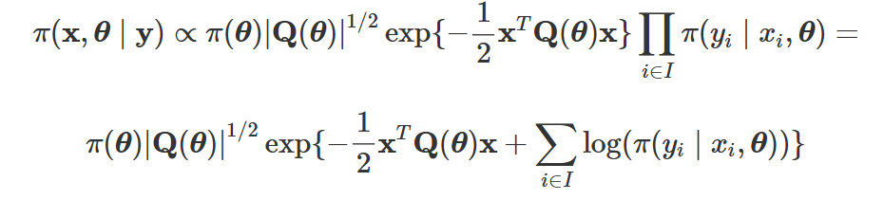
INLA MAth
The likelihood can be re-written as:
The joint distribution of Random effects and hyperparameters:
Because x is a GMFR, the posterior of the latent effects is:
At the end, the joint posterior distribution of the latent effects and hyperparameters can be written:

Slide 8
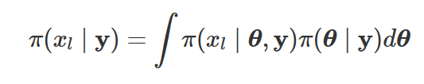

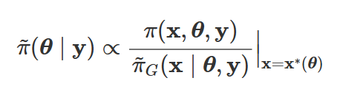





INLA will not attempt to estimate the previous posterior distribution but the marginals of the latent effects and hyperparameters.
For a latent parameter:
In a similar way, the posterior marginal for a hyperparameter:
The approximation to the joint posterior of θ, can be used to compute the marginals of the latent effects and hyperparameters as follows:
Posterior marginal can be approximated by integrating out in the previous approximation . Similarly, an approximation to posterior marginal using numerical integration, but a good approximation to is required.
Notes:
Here, θ−k is a vector of hyperparameters θ without element θk.
πG(x∣θ,y) is a Gaussian approximation to the full condition of the latent effects, and x∗(θ) represents the mode of the full conditional for a given value of the vector of hyperparameters θ.

Slide 9
Approximations
Gaussian
Laplace
Simplified Laplace Approximation (SLA)
Method | Accuracy | Computational Cost | Case
Gaussian | Low | Low | For well-behaved distributions
Laplace | High | High | When Precision is needed
SLA | Moderate to High | Moderate | Suitable for most of the cases

Slide 10
R-INLA
R package for Bayesian analysis using INLA.
Not on CRAN → install from the official INLA repository.
Supports spatial models, survival analysis, and more.
  install.packages("INLA", repos="https://inla.r-inla-download.org/R/stable")
  inla(formula, data, f, family, control.compute = list())
  inla(): Fits Bayesian models.
  f(): Defines random effects (spatial, temporal).
  control.compute: Computes model selection metrics.

Slide 11
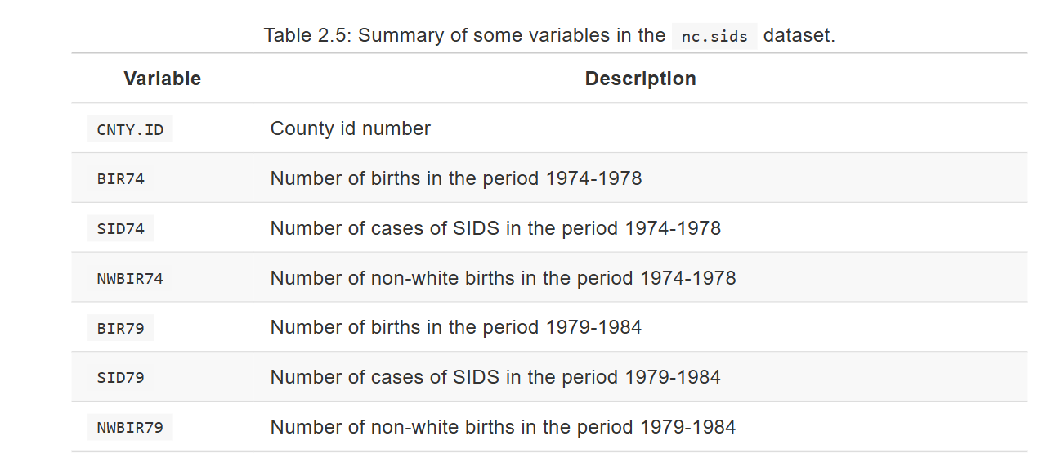
R-INLA
Data: The nc.sids dataset in the spData package contains information about the number of deaths by sudden infant death syndrome (SIDS) in North Carolina.

Slide 12
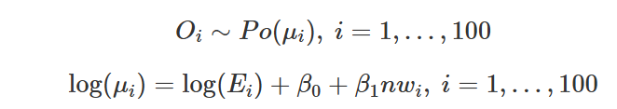
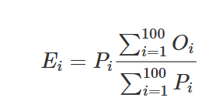
Case Study
These data can be modeled using a Poisson regression to explain the number of cases of SIDS in the available covariates. The period 1974-1978 will be considered, and the model to be fit is:
The expected number of cases is included as an offset in the model to account for the uneven distribution of the population across the counties in North Carolina.
It is computed by multiplying the overall mortality rate of SIDS by the number of births in each county Pi (which is the population at risk),
Notes:
Here, Oi is the number of cases of SIDS in county i, Ei the expected number of cases and nwi the proportion of non-white births in the same period.

Slide 13
R Implementation
library("spdep")
data(nc.sids)
# Overall rate
r <- sum(nc.sids$SID74) / sum(nc.sids$BIR74)
# Expected SIDS per county
nc.sids$EXP74 <- r * nc.sids$BIR74
# Proportion of non-white births
nc.sids$NWPROP74 <- nc.sids$NWBIR74 / nc.sids$BIR74
m.pois <- inla(SID74 ~ NWPROP74, data = nc.sids, family = "poisson", E = EXP74)
summary(m.pois)

Slide 14
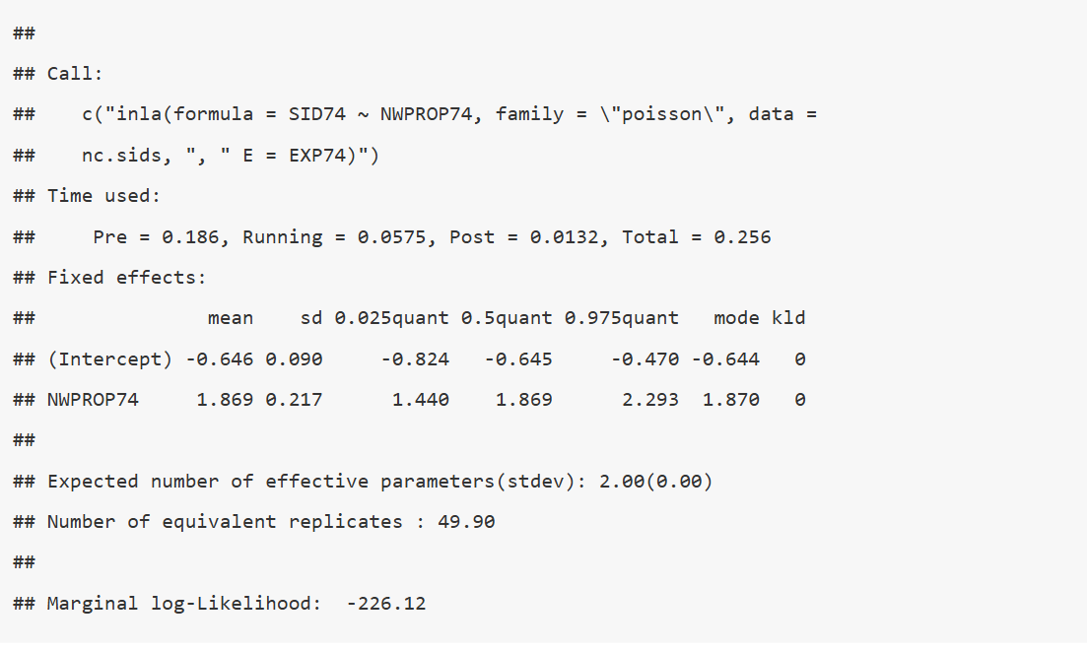
The results point to an increase of cases of SIDS in counties with a high proportion of non-white births.
Cressie and Read (1985) note the strong spatial pattern in the cases of SIDS, which produces overdispersion in the data. The inclusion of the proportion of non-white births has a similar spatial pattern and it accounts for some of the over-dispersion, but including a term to account for the extra variation can help to model overdispersion in the data. A simple way to include a term to account for overdispersion is to include i.i.d Gaussian random effects in the model.

Slide 15
Effect u is Gaussian distributed with zero mean and precision τ. By default, INLA will assign this precision a Gamma prior with parameters 1 and 0.00005. The random effect is included in the model by using the f() function
m.poisover <- inla(SID74 ~ NWPROP74 + f(CNTY.ID, model = "iid"),
data = nc.sids, family = "poisson", E = EXP74)

Slide 16
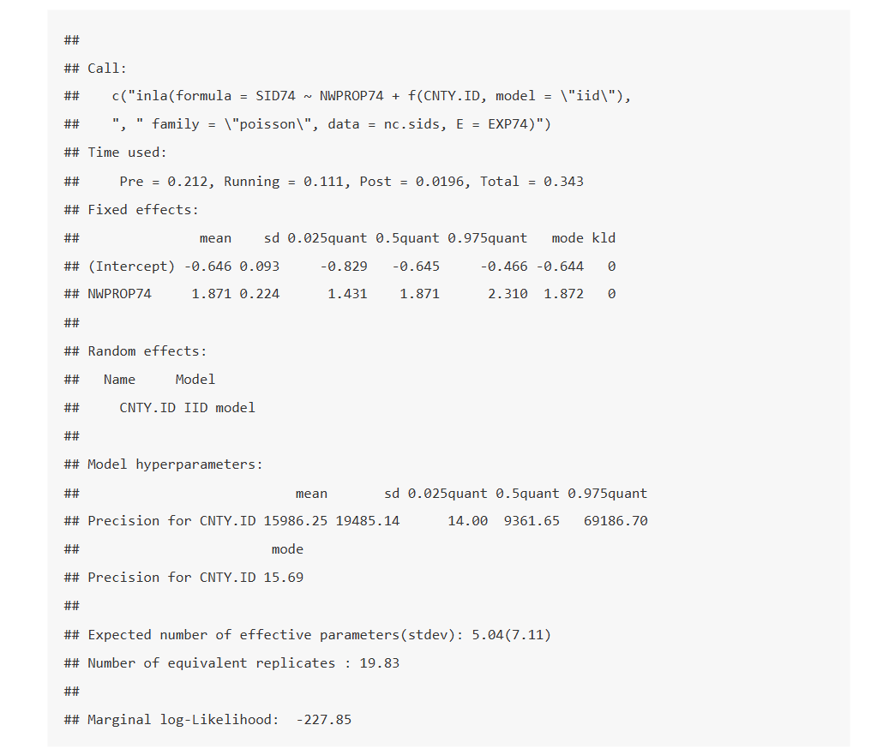
Note the large posterior mean and median of the precision of the Gaussian random effects. This probably indicates that the covariate explains the overdispersion in the data well.
Furthermore, the marginal likelihood of the latest model is smaller than that of the previous one, and it cannot be considered as a model with a better fit.
The new model is also more complex in terms of its structure and the estimated effective number of parameters. Hence, the model with no random effects should be preferred for this analysis.

Slide 17
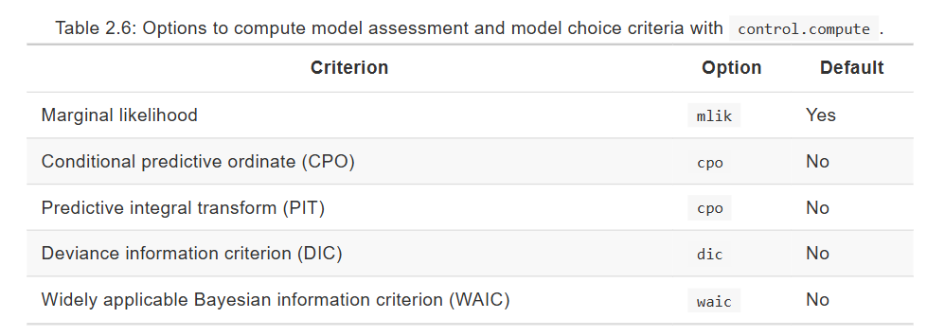
Model assessment

Slide 18
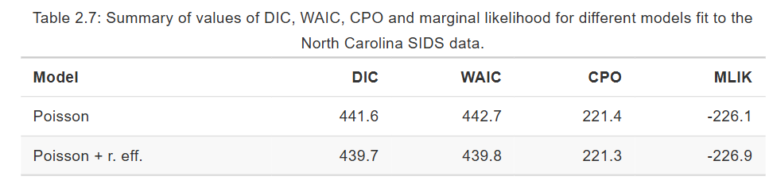
# Poisson model
m.pois <- inla(SID74 ~ NWPROP74, data = nc.sids, family = "poisson",
E = EXP74, control.compute = list(cpo = TRUE, dic = TRUE, waic = TRUE))
# Poisson model with iid random effects
m.poisover <- inla(SID74 ~ NWPROP74 + f(CNTY.ID, model = "iid"),
data = nc.sids, family = "poisson", E = EXP74,
control.compute = list(cpo = TRUE, dic = TRUE, waic = TRUE))
All criteria (but the marginal likelihood) slightly favor the most complex model with iid random effects. Note that because this difference is small, we may still prefer the model that does not include random effects.

Slide 19
Summary
✅ Bayesian methods (like R-INLA) provide better uncertainty quantification compared to frequentist methods.
✅ Spatial models help improve estimates by borrowing strength from neighboring areas, reducing noise in small-area estimates.
✅ R-INLA is a computationally efficient alternative to MCMC, making Bayesian inference accessible for large-scale disease mapping.
🔹 Why Bayesian Methods? → Handles small counts, prior knowledge, and uncertainty better.
🔹 Why R-INLA? → Faster than MCMC, easy to use, and supports spatial models.
🔹 Model Comparison Matters! → WAIC, DIC, and CPO help us pick the best model.

Slide 20
Thank you
Navid Mohseni

